Slide 1
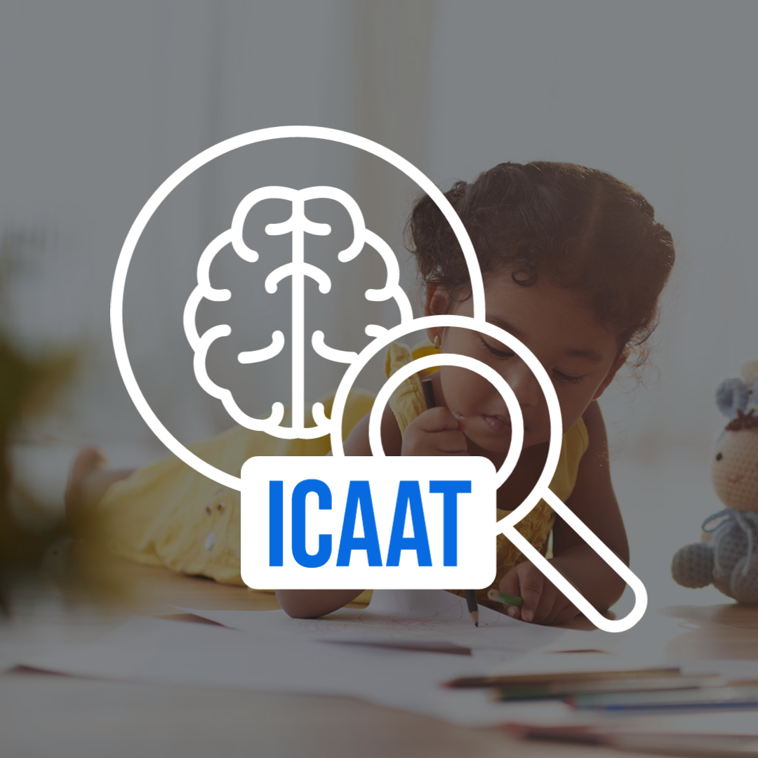

Intelligent Cognitive Ability Assessment Tool
2022 - 073

Slide 2

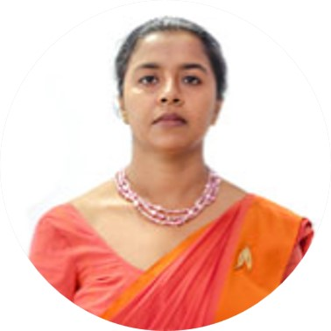
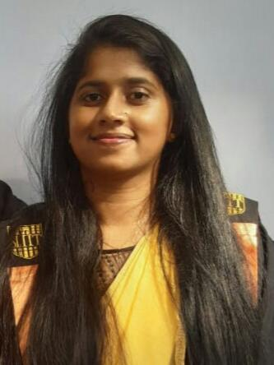
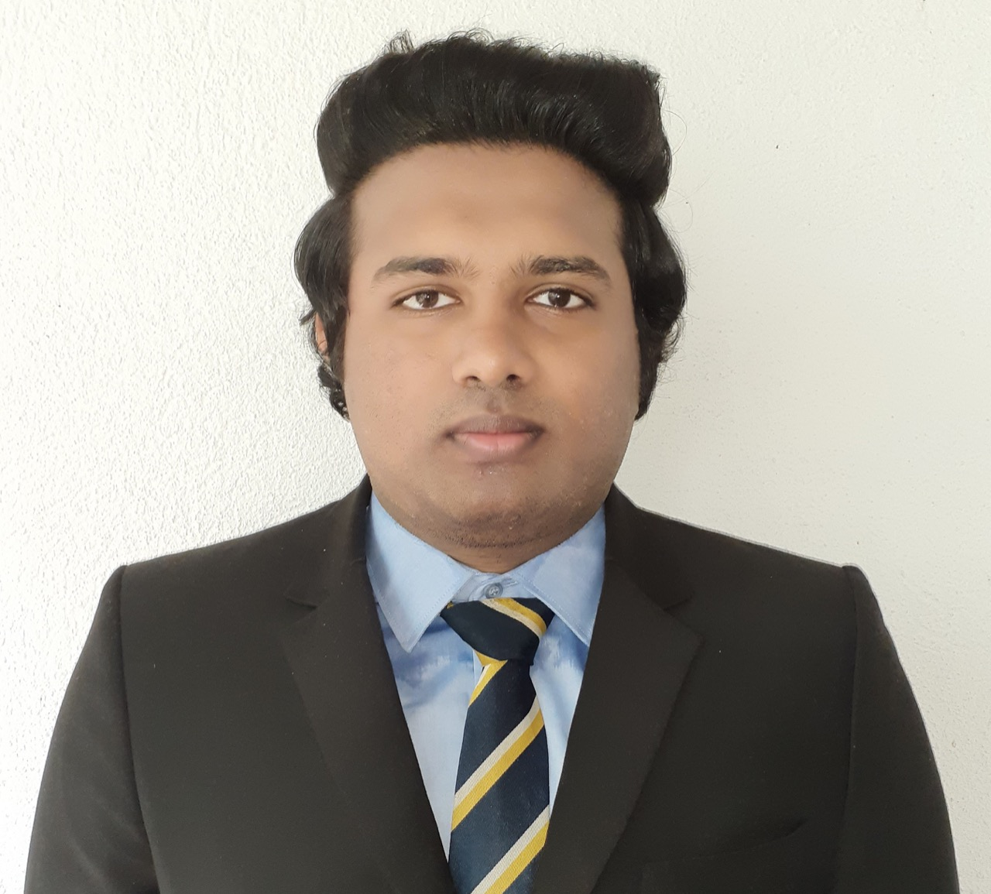
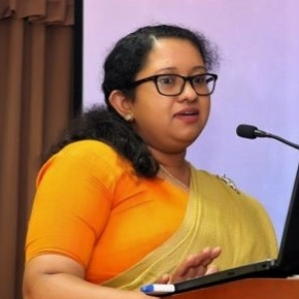
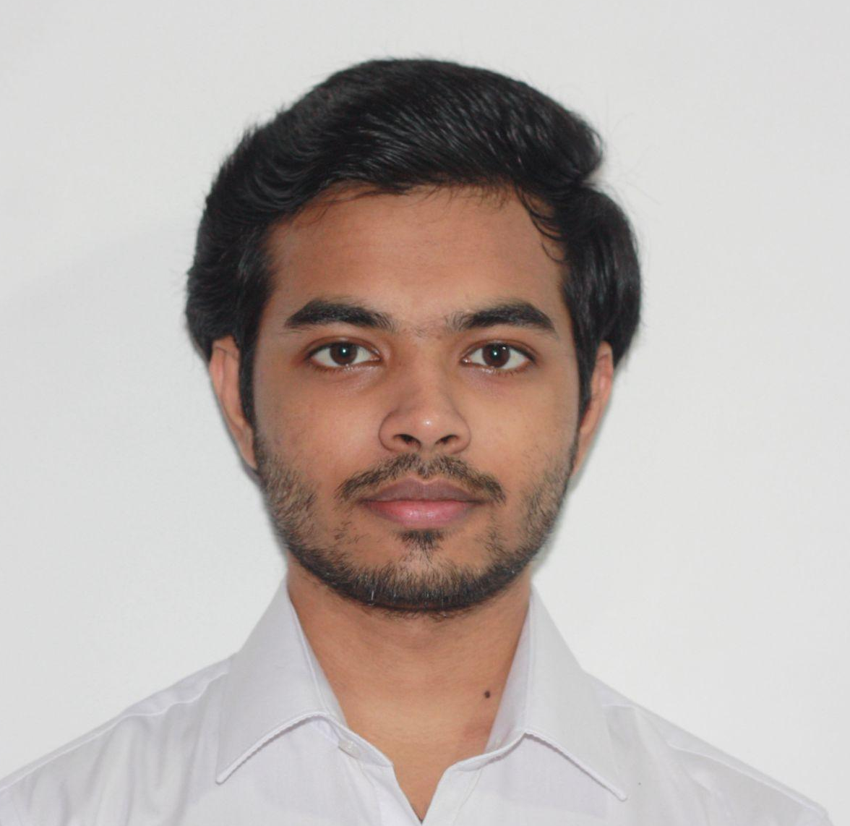
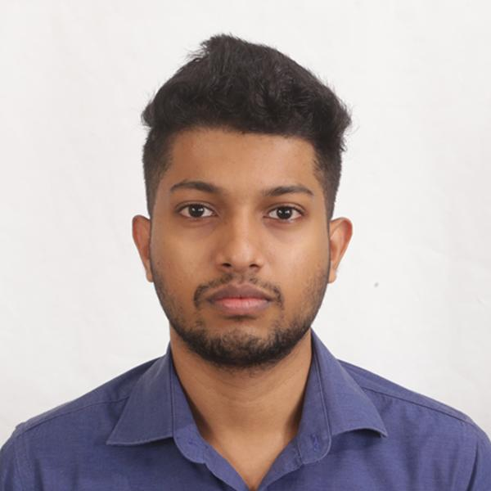
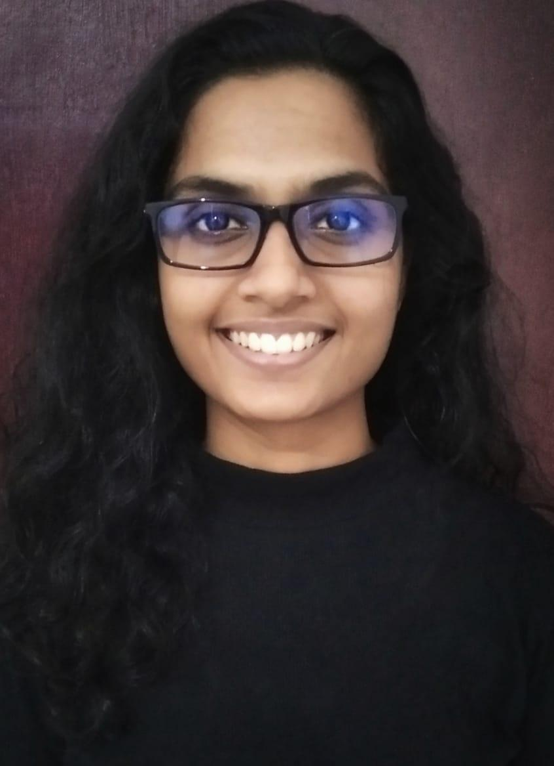
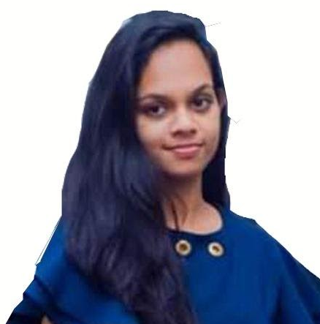
Team Members
Dr.Pradeepa Samarasinghe Supervisor
Ms.Madhuka Nadeeshani Co-Supervisor
Mr.Asiri Lindamulage Co-Supervisor
Dr.Asiri Hewamalage External Supervisor
Kahawanugoda M.A.I Team Leader
Meegoda M.N.D Team Member
Gnanarathna E.D.K.V Team Member
Monarawila C.H.M.R.P.K. Team Member
2022 - 073

Slide 3
Research Problem
2022 - 073

Slide 4

Problem Definition
A comprehensive cognitive examination of children is not conducted in Sri Lanka. Due to,
the lack of a culturally appropriate tool that can be used in the local languages.
the high commercial expenses associated with globally recognized cognitive assessment tools[4].
2022 - 073

Slide 5
ICAAT
2022 - 073

Slide 6

Background
What can ICAAT do?
Analyze The Development Of Child Cognitive Abilities in Sri Lanka
What will get evaluated?
Mental chronometry
Perceptual reasoning
Working memory
Attention span
Scope -
Sinhala language speaking
Sri Lankan children
Age between 7 - 9 years
2022 - 073

Slide 7
Research Gap (Overall Project)
Existing international child cognitive assessment tools?
Wechsler Intelligence Scale for Children (WISC)
Stanford-Binet (SB)
Then why can’t we use existing tools?
Cognitive ability analyzing tools must be tailor made considering targeted scope, culture, country and language.
2022 - 073

Slide 8

Research Objectives
Research suitable technologies and apply appropriate methodologies and designs to automate,
Knowledge IQ
Reasoning IQ
Mental chronometry
Attention level
assessments for Sri Lankan children between the ages of 7-9 years.
2022 - 073

Slide 9
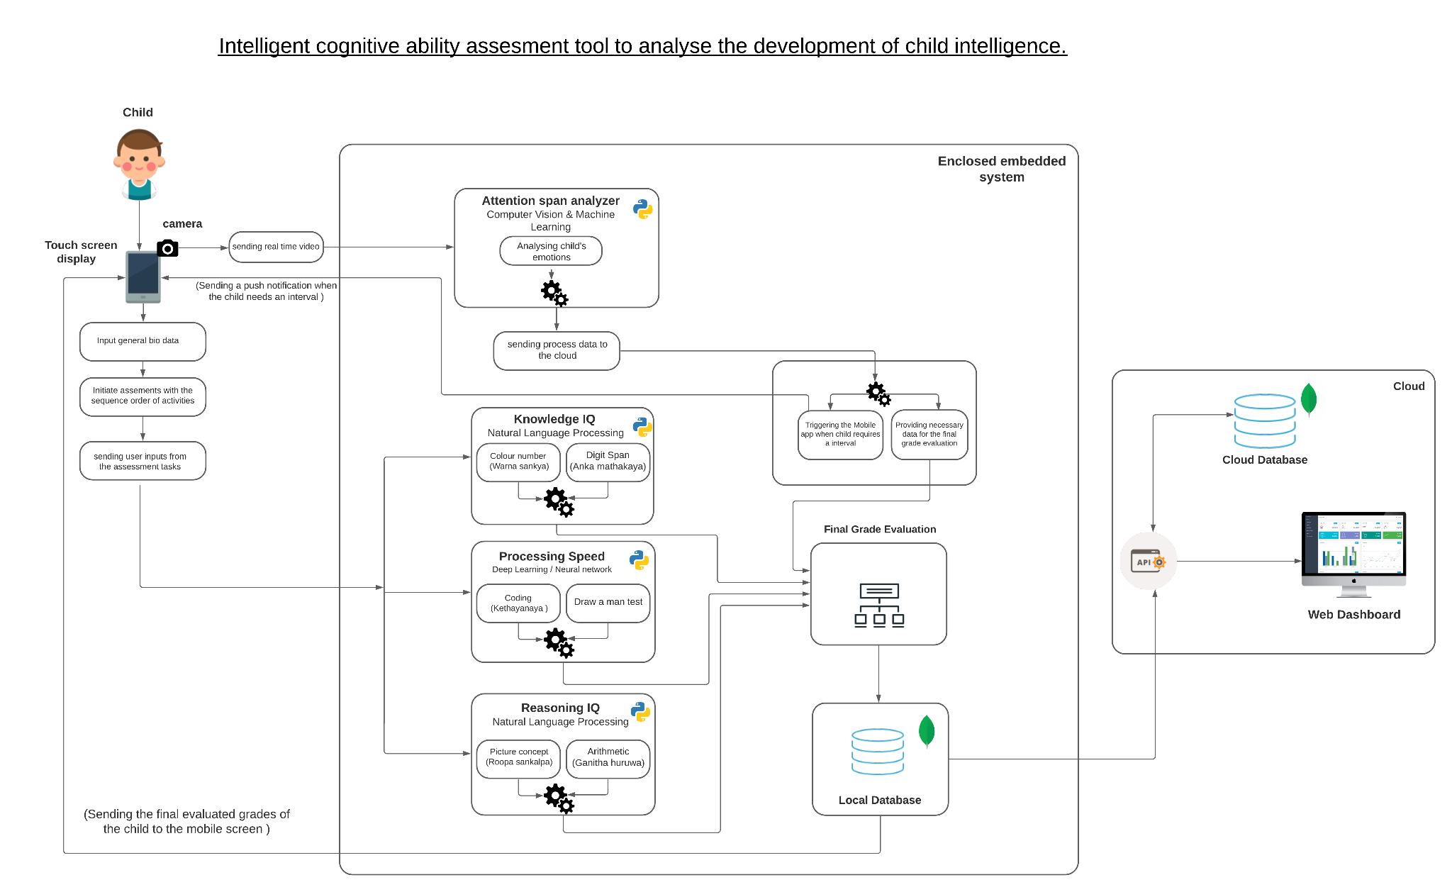
System Diagram
Reasoning IQ
Knowledge IQ
Mental chronometry
Attention span
2022 - 073

Slide 10










100%
100%
100%
100%
Reasoning IQ
Knowledge IQ
Mental Chronometry
Attention Level
Natural Language Processing
Natural Language Processing
Neural Network
Computer Vision and Neural Network
Mainly assess,
Open Domain Speech Utterances
Mainly assess,
Limited Vocabulary Speech Utterances
Mainly assess,
Handwritten sinhala letter classification
Hand drawn and computer generated shape classification
Mainly assess,
Facial behaviors
Head movements

Slide 11
Reasoning IQ Evaluation (Overview)
IT19105208 - Kahawanugoda M.A.I.
Research Problem | How to develop successful ASR model by identifying suitable technologies, techniques and hyper-parameter tunings to achieve best results in Sinhala open-domain child speech recognition?
Research Gap | Absence of open domain child speech recognition for the Sinhala language and automated and validated cognitive ability tests-based tool specifically developed to scale Reasoning IQ of Sri Lankan Children.
Provided Solution | Psychologically validated approach, strengthened with automation and machine learning to evaluate Sinhala Speaking children’s reasoning capabilities.
Data Collection | Combination of both child and adult speech data * 178,260 utterances * 50,863 unique words
Model Training | GMM-HMM acoustic model (31.6 WER%) Feature extraction - using MFCC 3 Stages of training, aligning and decoding
Product Development | -Conduct 2 activities to measure Reasoning IQ -Unbiased UI/UX designs -Analytical view of activity results on web dashboard

Slide 12
Knowledge IQ Evaluation
Research Problem | How to develop successful Deep Learning ASR model by identifying suitable technologies and hyper-parameter tunings to achieve Sinhala child speech recognition for Limited Vocabulary?
Research Gap | Absence of limited vocabulary child speech recognition for Sinhala language using deep neural networks. Absence of an automated and validated cognitive ability tests-based tool specifically developed to scale Knowledge IQ of Sri Lankan Children.
Provided Solution | Limited vocabulary sinhala speech recognition infused with a validated approach to measure Knowledge Iq in children.
Data Collection | Combined collection of Adult and Child Utterances *Adult - 850 utterances *Child - 600 utterances
Model Training | Utilized CNN model (97% Accuracy) with MFCC feature extraction methods to extract characteristics in child speech utterances.
Product Development | -Conduct 2 activities to measure Reasoning IQ -Unbiased UI/UX designs -Analytical view of activity results on web dashboard
IT19091044 - Gnanaratna E.D.K.V.

Slide 13
Mental Chronometry Evaluation
Research Problem | How to develop image classification system to classify hand drawn geometric shapes, hand written sinhala letters and geometric shapes to evaluate mental chronometry of sri lankan sinhala speaking children?
Research Gap | Absence of sinhala child letter data set Absence of validated child sinhala letter classification system with reasonable accuracy
Provided Solution | Image classification system to classify hand drawn geometric shapes, hand written sinhala letters and geometric shapes
Data Collection | Combination of collected sinhala letters(by visiting schools) and computer generated letters(89943) Combination of collected (by visiting schools) and online available hand drawn shape data sets(16208) Combination of online available geometric shape data sets (3000)
Model Training | Utilized CNN model with image preprocessing techniques and data augmentation techniques. Transfer Learning techniques used to improve accuracies. Letter model - 95% | Geometric shape model - 97% | Hand drawn shape model- 89%
Product Development | -Conduct 3 activities to measure Reasoning IQ -Unbiased UI/UX designs -Analytical view of activity results on web dashboard
IT19170480 - Monaravila C.H.R.P.K.

Slide 14
Attention Level Evaluation
Research Problem | How to develop a low resource ensemble model to predict the attention levels of sri lankan children by identifying the suitable parameters required
Research Gap | Absence of an automated mechanism to continuously measure and monitor the attention span of a child specifically developed based on Sri Lankan Children.
Provided Solution | Development of a head pose estimation, a blink rate detection, a facial expression recognition and a eye gaze estimation models. Development of a neural network to identify the attention levels based on the above parameters
Data Collection | Custom dataset created using the outputs from the parametric models Mediapipe framework for face detection & landmark detections FER2013 dataset - Facial expression model LIRIS Children Spontaneous Facial Expression Dataset - Facial expression model
Model Training | Attention level model : 89 % Face recognition model : 92%
Product Development | -Conduct 2 activities to measure Reasoning IQ -Unbiased UI/UX designs -Analytical view of activity results on web dashboard
IT19105826 - Meegoda M.N.D.

Slide 15
Project Completion
Model Training &
Deployment
Backend API
Implementation
Frontend Implementation
System Integration
100%
100%
100%
100%

Slide 16
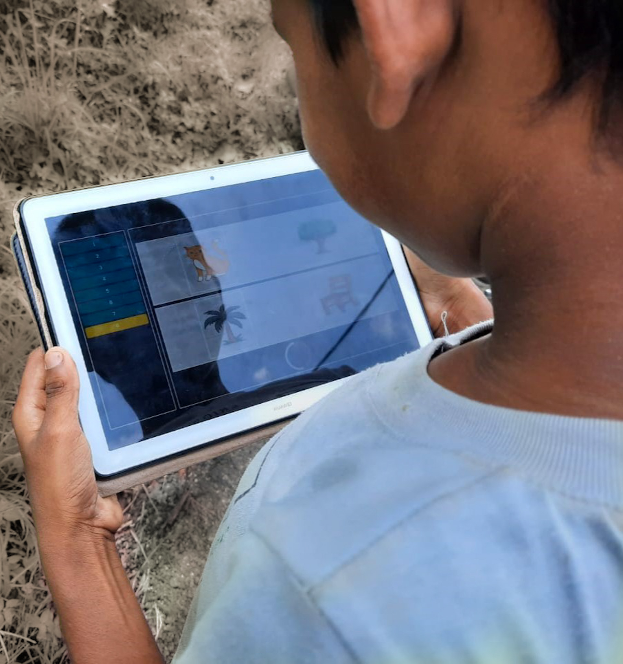
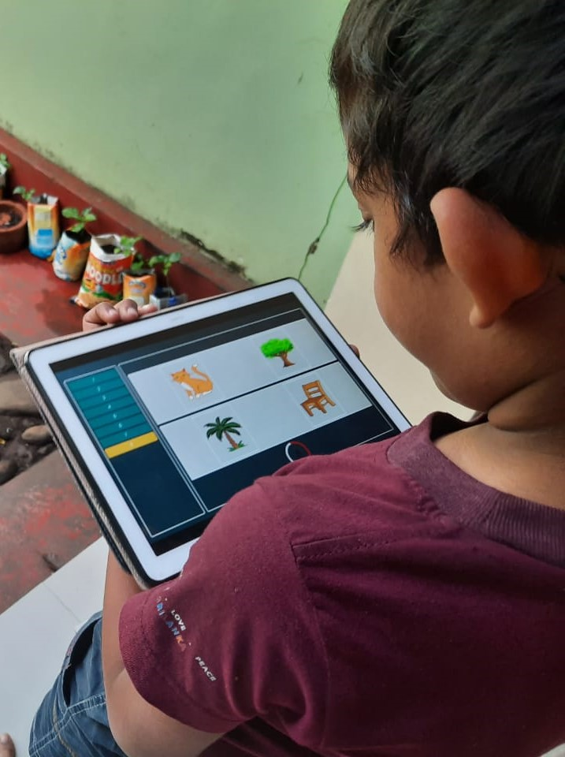
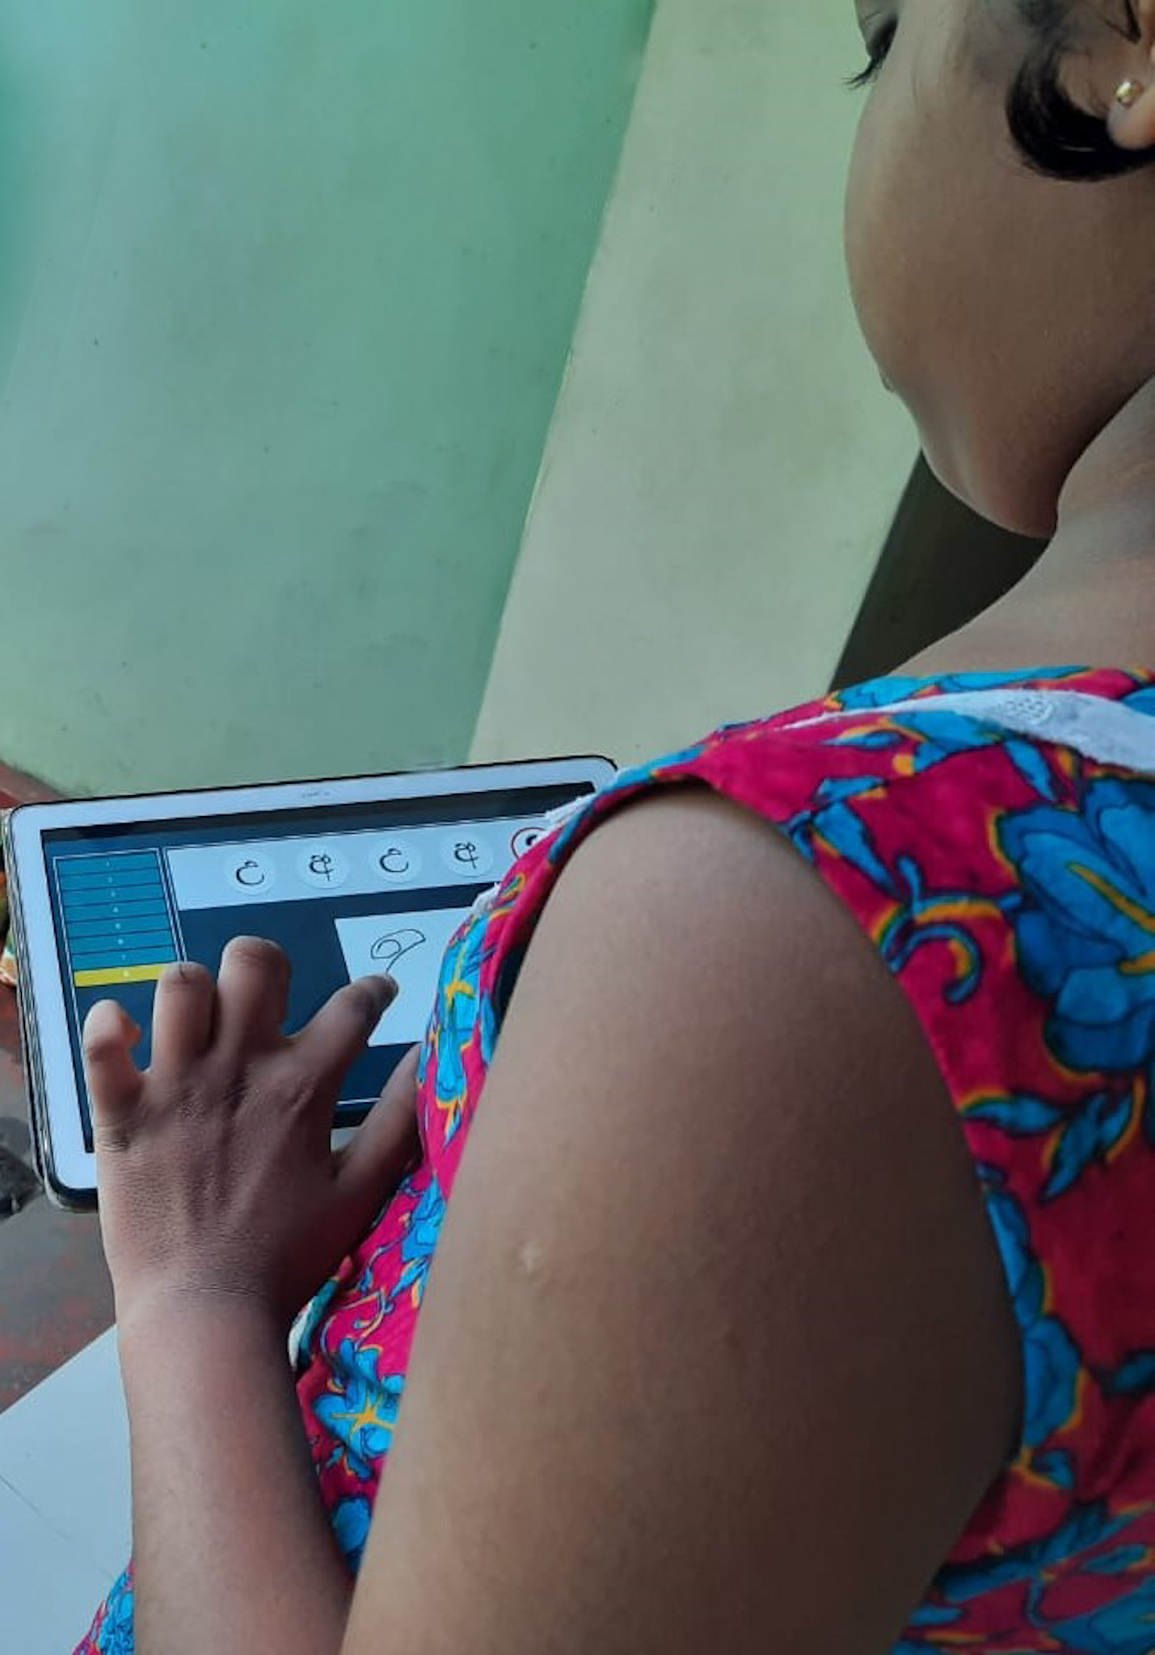
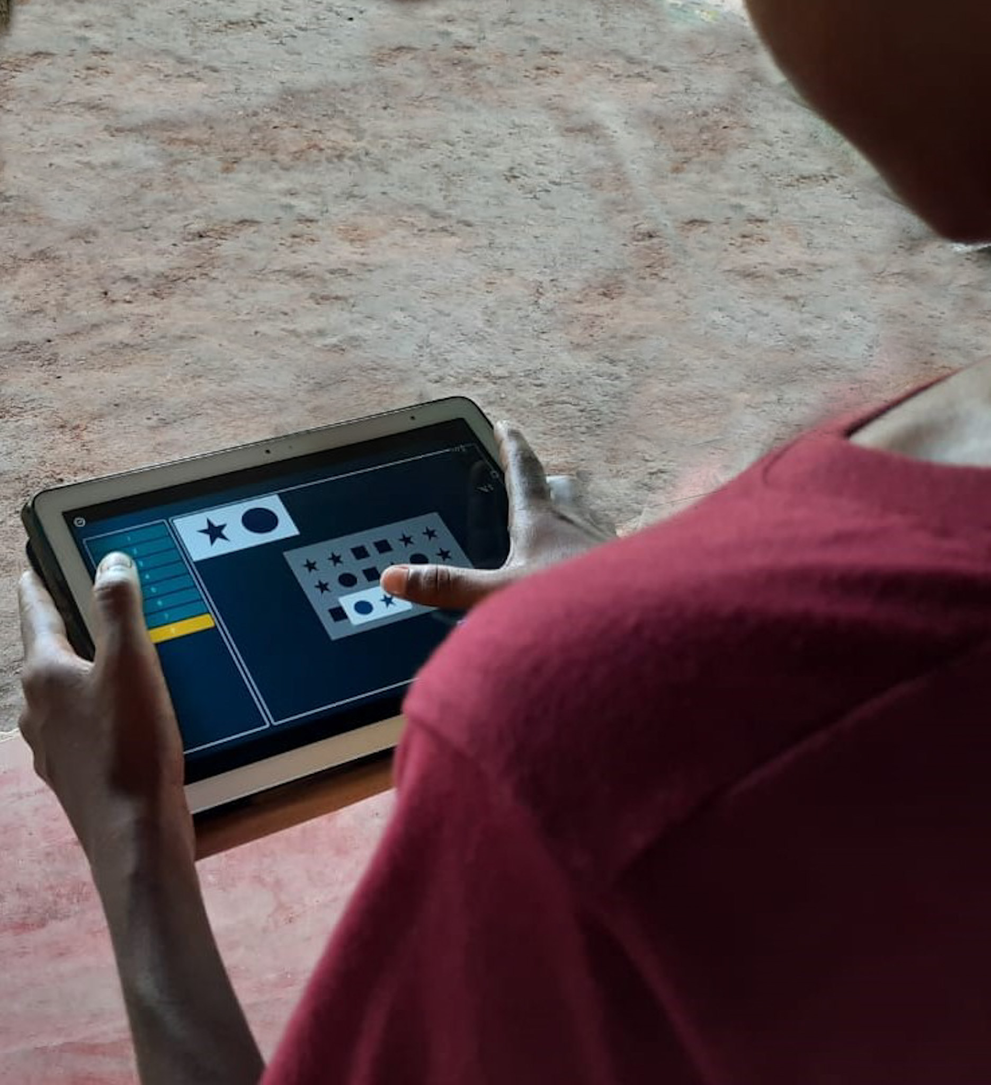
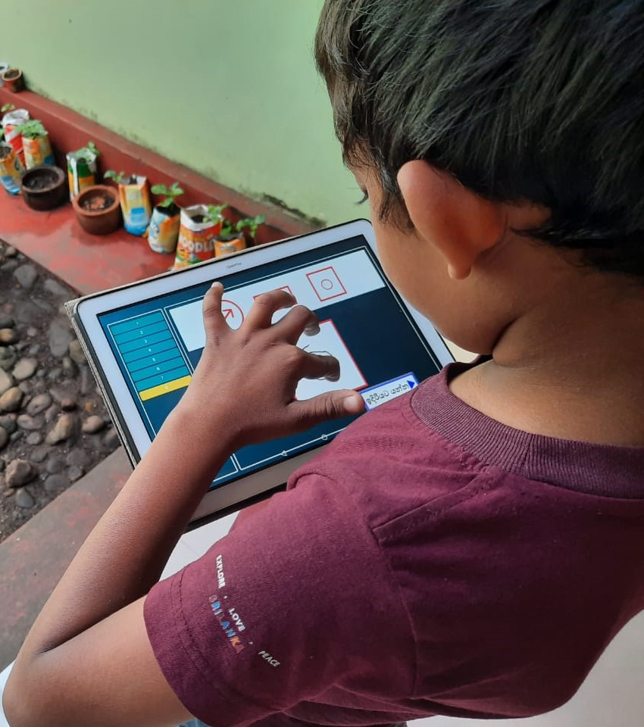
Location - Kurunegala MOH

Slide 17
Commercialization
2022 - 073

Slide 18
Commercialization
Consumers
Paediatric Hospitals in Sri Lanka
For example, LRH (Lady Ridgeway Hospital for Children)
1
Product Differentiation
ICAAT is by far Sri Lanka’s first automated screening tool to measure cognitive intelligence in Sinhala Speaking children
2
3
Market Access Monitoring
Optimized Pricing, Marketing Strategy.
Stanford Binet -$1258 (Approx. Rs. 5 Lakhs )
Commercial Opportunity
Monetization Strategies, User Reviews .
4
5
Commercial Investments
Scaling product, Adapt clientele

Slide 19
Considerations
2022 - 073

Slide 20
Considerations
Social
Data Collection and Requirements Gathering hindered due to,
Global Pandemic Situation
Sri lankan Economic Crisis
Standards/Best Practices
Consistency in product UI/UX design
05
01
04
Security
Inaccessibility of data to external parties with no permission to it.
Professional and Legal
Approval from National Health Bureau Child Development Unit
Non-disclosure agreement for data/information protection on child cognitive normative references
Privacy Policy agreements
02
03
Ethical
Parent consent before conducting activities with children
Not saving video/audio data of candidates

Slide 21
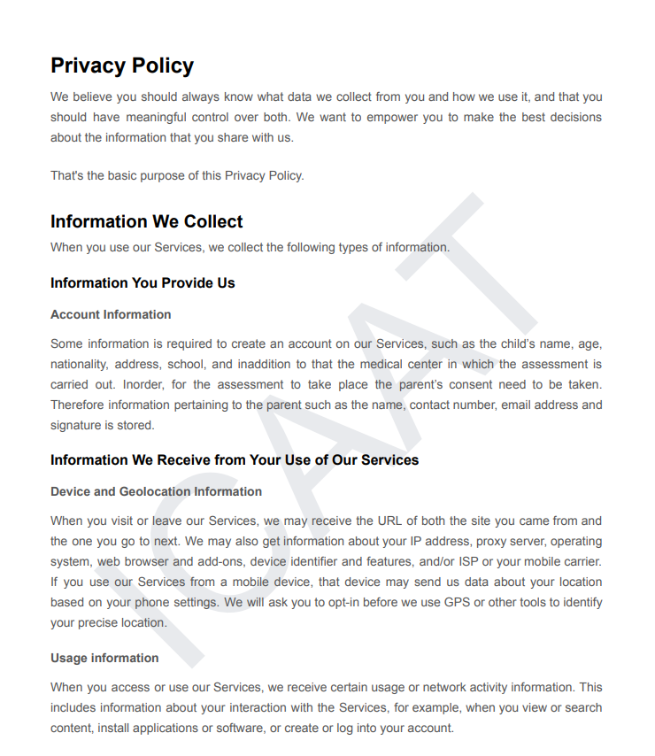
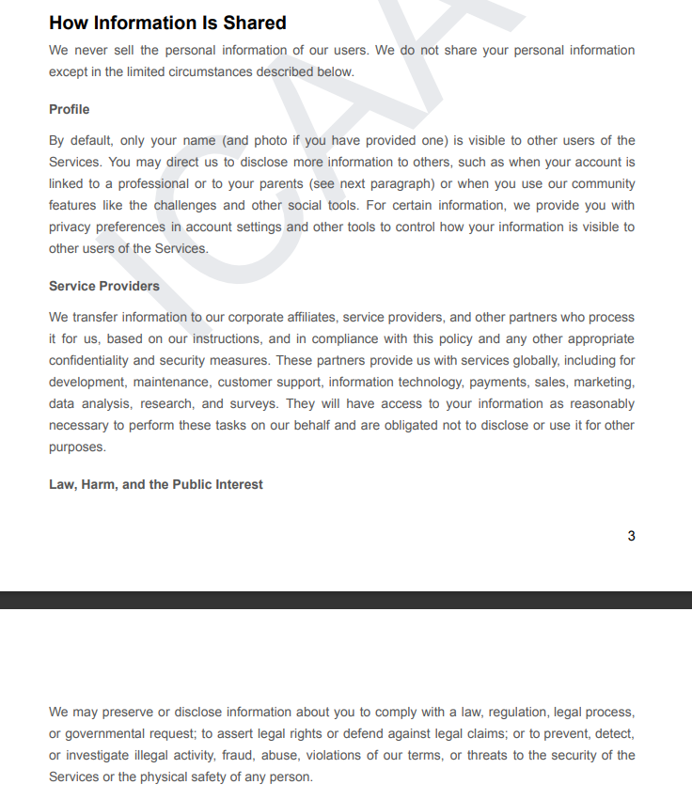
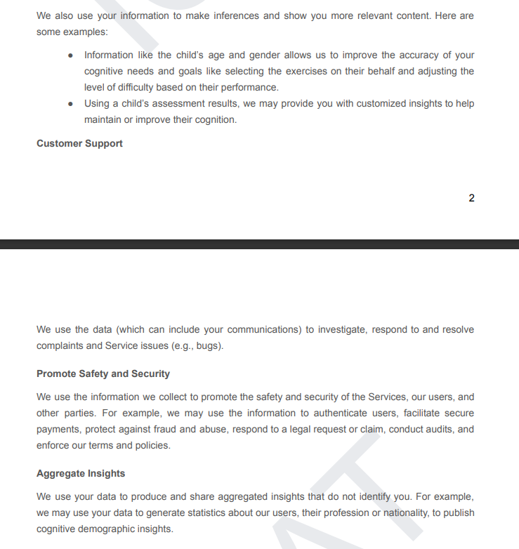
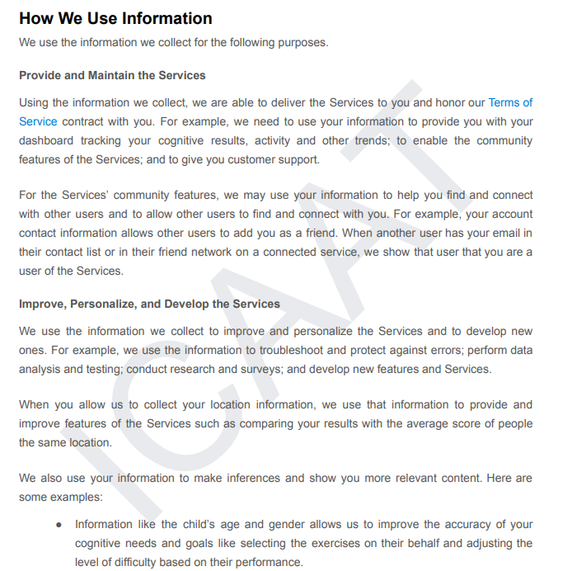
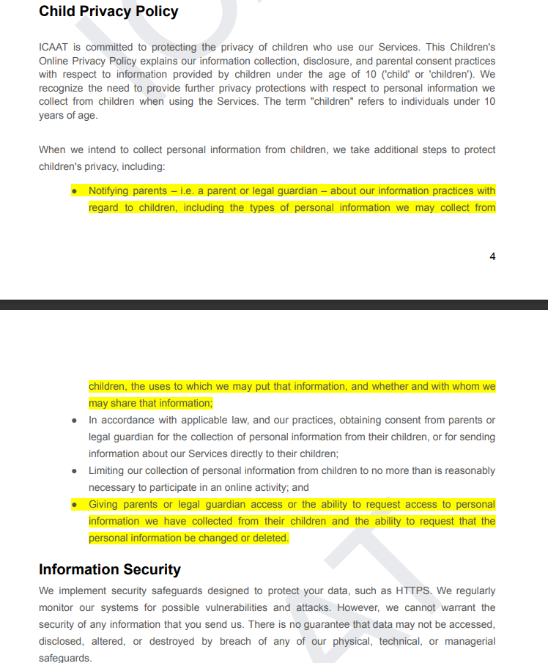
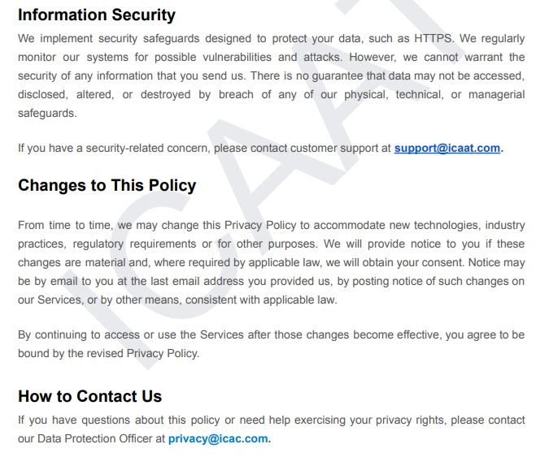

Slide 22
Non-Functional Requirements
2022 - 073

Slide 23
Non-functional Requirements
01
Compatibility
Web application
Progressive Mobile Application
Compatible for different screen resolutions
02
Security
Limited authorized user-base
Authentication and Authorization on analytical web dashboard
03
Scalability
Solution product is implemented in a way that can integrate more functionalities and cognitive assessments
04
Reliability
Products ensure privacy
It can be accessed anytime with authorized devices
05
Maintainability
When creating product followed a clean and consistent coding standard.

Slide 24
Publication Work
2022 - 073

Slide 25
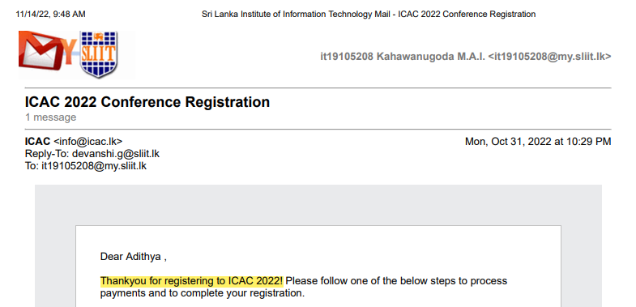
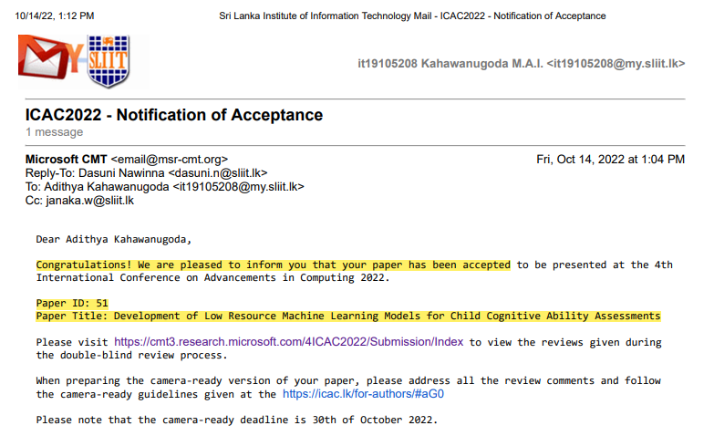
Research Publication

Slide 26
References
[1] A. Hewamalage, “Normative references of cognitive abilities and its correlates among primary school child population in Colombo District,” 2015.
[2] G. Aradilla and J. Ajmera, "Detection and Recognition of Number Sequences in Spoken Utterances," in 2nd Workshop on Speech in Mobile and Pervasive Environments (SiMPE), 2007.
[3]R. Sharmin, S. K. Rahutb and M. R. Huq, "Bengali Spoken Digit Classification: A Deep Learning Approach Using Convolutional Neural Network," in Third International Conference on Computing and Network Communications (CoCoNet’19), 2020
[4]K. A. D. Dilshan, "Transcribing Number Sequences in Continuous Sinhala Speech," 2021.
2022 - 073

Slide 27


